Slide 1
COMP5523 Lab 3
Neural Networks

Slide 2
Outline
Pytorch (150 pts)
Neural networks by numpy (100 pts + 20 bonus pts)

Slide 3
Due: May 25 at 23:59 pm

Slide 4


Pytorch vs Tensorflow
https://pytorch.org/
https://www.tensorflow.org/
Dynamic DAG
Static DAG

Slide 5
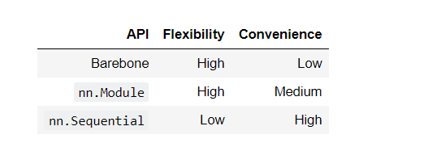

Slide 6
Dataset
CIFAR-10: https://www.cs.toronto.edu/~kriz/cifar.html
MNIST: http://yann.lecun.com/exdb/mnist/
Remarks: Default is CIFAR-10. Change the input size to [3, 32, 32] to [1, 28, 28] if you use MNIST

Slide 7
Outline
Pytorch
Neural networks by Numpy

Slide 8
Weights initialization
Forward
Backward
updated
Two-layer nets
Multilayer nets

Slide 9
Multilayer Nets (Basic Version)
Affine
Relu
Affine
Relu
Affine
Softmax
...
Repeat L-1 times
{affine-relu} X (L - 1) - affine - softmax

Slide 10
Multilayer Nets (Bonus Version)
Affine
Norm
Relu
dropout
Affine
Norm
Relu
dropout
Affine
...
Softmax
Repeat L-1 times
{affine - [batch/layer norm] - relu - [dropout]} x (L - 1) - affine - softmax
Dropout: https://www.cs.toronto.edu/~hinton/absps/JMLRdropout.pdf
Batch/layer norm: https://arxiv.org/abs/1502.03167

Slide 11
Dataset: Lab3/comp/datasets.sh
Code you should read:
layer_utils.py
optim.py
solver.py
layers.py
Code you should complete
Lab3/comp/layers.py
Lab3/comp/classifiers/fc_net.py

